Slide 1

ARTIFICIAL INTELLIGENCE
PRESENTED BY :
AIMEN JILLANI (2021-BCS-001)
KAINAT BIBI (2021-BCS-017)
MARYAM SIDDIQUI (2021-BCS-027)
NASTASHA KANWAL (2021-BCS-032)
NOOR FATIMA (2021-BCS-035)
WISHMA NOOR (2021-BCS-041)

Slide 2
GENDER , AGE EMOTION DETECTION
PROJECT

Slide 3
OUTLINE
INTRODUCTION
COMPUTER VISION
METHODOLOGY
AGE AND GENDER AND EMOTION DETECTION
CNN ARTITECTURE
DATASET
CONCLUSION

Slide 4
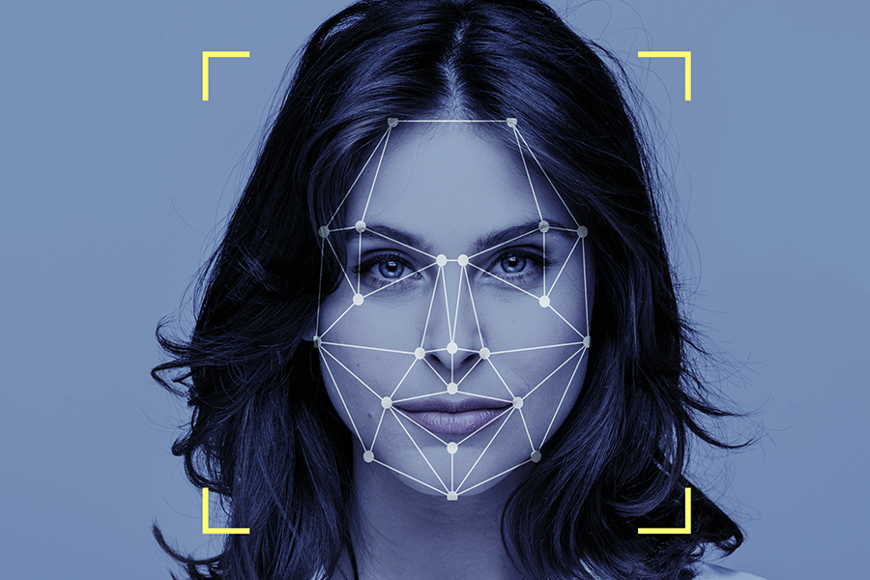
INTRODUCTION
The project aims to utilize deep learning to accurately predict age, gender, and emotions from facial images, facilitating seamless integration into various systems via web or mobile interfaces for practical applications in diverse domains.

Slide 5
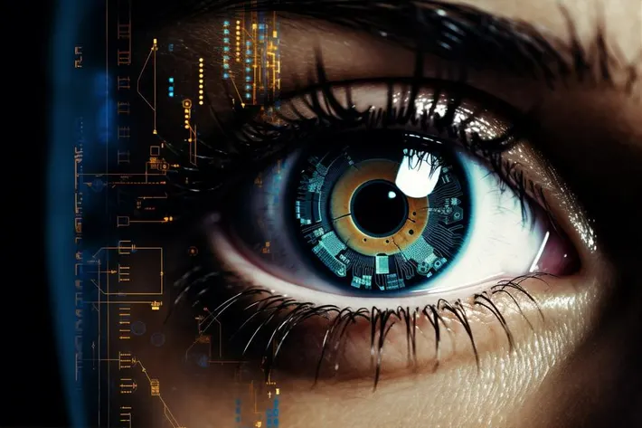

COMPUTER VISION
Computer Vision enables computers to interpret digital images and videos akin to human perception, involving tasks like object recognition and motion estimation. Its challenges arise from replicating the intricacies of biological vision, encompassing acquisition, analysis, and understanding of visual data.

Slide 6

Methodology
The research explores CNN-based age and gender prediction from facial images, utilizing various datasets and methodologies. Studies employ neural networks for precise classification, comparing RGB and grayscale images across different testing scenarios. Practical applications, including Android apps for retail, demonstrate the relevance of this research in real-world settings.
The work flow of the proposed age and genderand emotion predictor is
Capturing Video In Real-Time
Command For Image Analysis: Python Detect.Py --Image <Image_Name>
Age Detection
Gender Classification
Emotion Detection
Smile Detection And Save The Picture

Slide 7

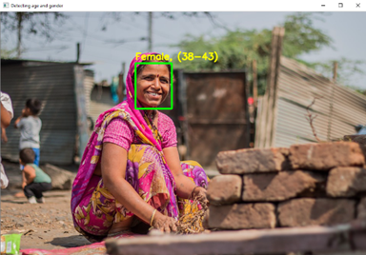

Capturing Video In Real-Time
OpenCV facilitates real-time video capture from webcams or input devices, converting streams into image frames for analysis. Essential for real-time applications like surveillance and interactive installations, enabling live event monitoring.

Slide 8

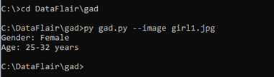
Command For Image Analysis
Python Detect.Py --Image <Image_Name>
This command allows the user to analyze a specific image for gender and age detection. The image must be located in the same directory as the script for successful processing.

Slide 9

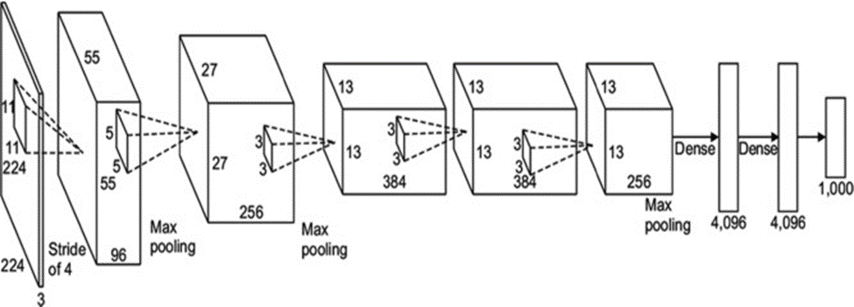
GENDER AND AGE DETECTION
Using CNNs for estimating age from facial images provides greater accuracy than traditional methods such as SVMs, and requires less pre-processing. The process involves training with large, labeled datasets and employing image standardization and augmentation to improve model reliability across various applications like advertising and security.

Slide 10
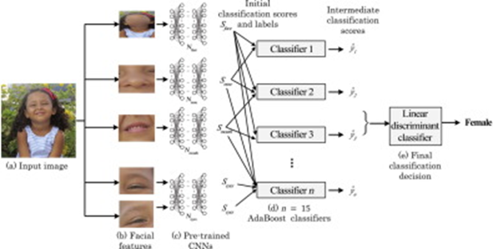
GENDER AND AGE DETECTION

Slide 11
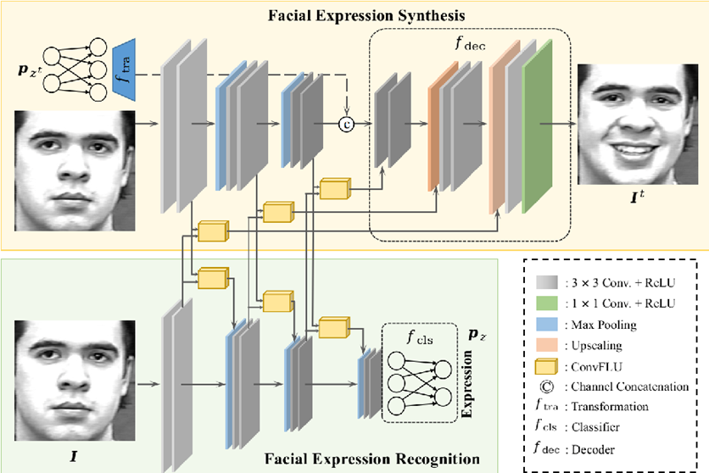
EMOTION DETECTION
DeepFace, developed by Facebook, is a facial recognition system that employs a nine-layer neural network trained on four million images to achieve high accuracy in identifying faces. It also excels in emotion detection, using datasets like CK+, FER-2013, and JAFFE, despite challenges like imbalanced emotion distributions. This robustness in emotion recognition makes DeepFace useful for security, surveillance, and enhancing digital user experiences.

Slide 12

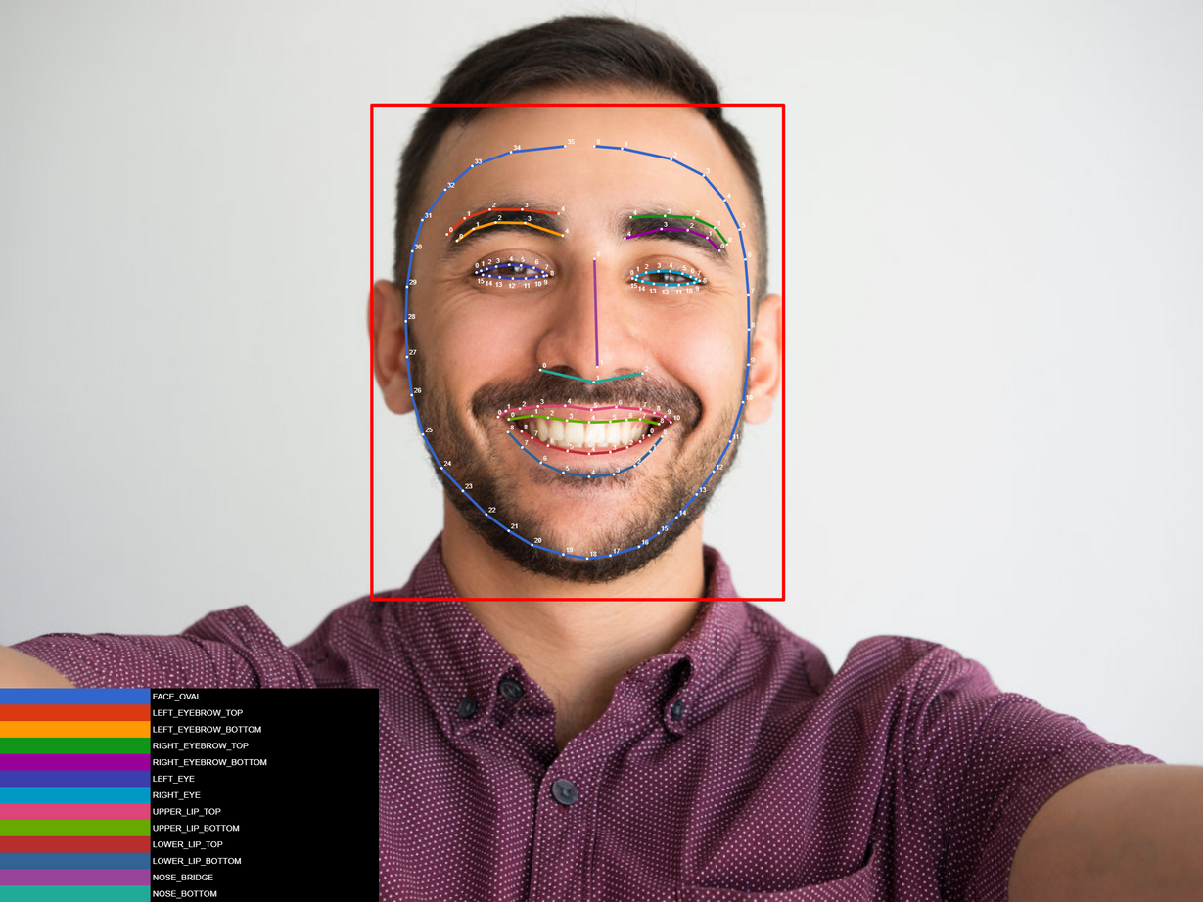
SMILE DETECTION
Using Python and OpenCV, you can create a smile detection system that captures live video feed from a webcam, employs a pre-trained Haar Cascade Classifier to detect smiles in real-time, and saves snapshots of smiles to a specified folder. This system, crucial for applications such as media industry analytics, simplifies capturing and analyzing emotional responses, enhancing user experience studies and interactive installations.

Slide 13



Libraries and packages
OpenCV
TenserFlow
Haar Cascades for Face Detection
OpenCV is an open-source library for computer vision and machine learning, facilitating real-time image and video processing and compatible with deep learning frameworks like TensorFlow, Caffe, and PyTorch for various applications including motion detection and face recognition.
TensorFlow is a versatile and scalable open-source machine learning framework by Google, known for its flexibility and wide ecosystem, which supports the development and deployment of machine learning models on diverse platforms.
Haar cascades are object detection methods used primarily for face detection in images or videos, utilizing a cascade function to focus analysis on potential face areas, preferred for their accuracy despite slower processing times compared to alternatives like LBP Cascade Classifier.
DeepFace
ARGPARSE
argparse: argparse is a Python library for building command-line interfaces, enabling easy parsing of command-line arguments and options to create user-friendly command-line applications.
DeepFace Package: DeepFace, developed by Facebook, is a facial recognition system using a nine-layer neural network trained with over four million images from Facebook users, capable of accurately identifying human faces.

Slide 14
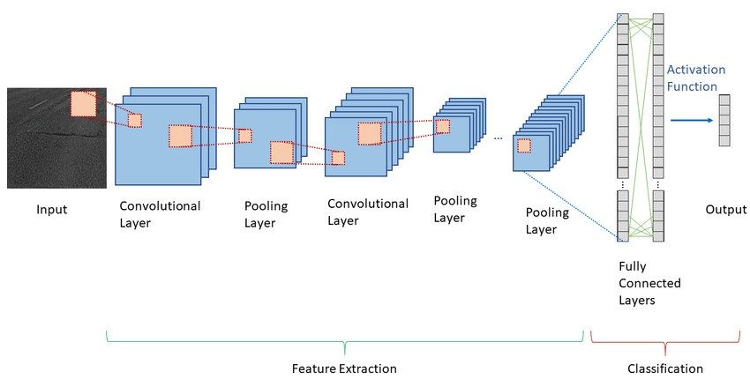
CNN ARTITECHTURE

Slide 15

01
Hassner and Levi Dataset
The Hassner and Levi Dataset is tailored for age and gender classification, featuring diverse images to train models for high accuracy across various demographics.
02
CK+ Dataset
The CK+ Dataset comprises 732 labeled images for facial expression recognition, aiding in the nuanced detection of emotions like happiness, disgust, and fear.
DATASETS
03
FER-2013 Dataset
The FER-2013 Dataset offers a collection of images labeled for seven emotional states, facilitating the development of robust emotion recognition models with diverse facial expressions.
04
JAFFE Dataset
The JAFFE Dataset provides labeled images of female facial expressions, aiding research in facial expression recognition with a focus on consistency and accuracy across controlled, high-quality images.

Slide 16
CONCLUSION
This project showcases the capabilities of deep learning within the domain of computer vision, particularly in the domain of recognizing and categorizing human facial attributes such as gender and age. Despite facing challenges such as variations in imaging conditions and the complexities of human facial features, the application achieves impressive accuracy levels owing to the robustness of Convolutional Neural Network (CNN) models and the extensive Adience dataset it relies on.
1. Facial Detection and Recognition
2. Gender and Age Detection:
3. Emotion Detection:
4. Smile Detection:
5. Real-time Processing:
6. Modularity and Extensibility:
Network (CNN) models and the extensive Adience dataset it relies on.
By leveraging CNNs, the project is able to effectively learn and extract features from facial images, allowing it to accurately classify individuals into gender and age groups. The Adience dataset, which serves as the foundation for training the model, provides a diverse range of facial images captured under various conditions, enabling the model to generalize well to real-world scenarios.
Furthermore, optimizing the algorithm for real-time applications would be beneficial, allowing for faster and more efficient processing of facial data. This could involve techniques such as model compression, quantization, or implementing specialized hardware accelerators.

Slide 17
REFERENCES
https://www.sciencedirect.com/science/article/pii/S2214785320362222#b0030
https://www.kdnuggets.com/2019/04/predict-age-gender-using-convolutional-neural-network-opencv.html
https://www.geeksforgeeks.org/age-and-gender-prediction-using-cnn/
https://medium.com/@skillcate/gender-detection-model-using-cnn-a-complete-guide-279706e94fdb

Slide 18
Thank you

